Slide 1
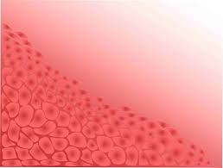
Types of tissue

Slide 2
Reading page 43-48

Slide 3
Use the information on pages 43-48 to complete the following table
 | Characteristics | Examples | Importance | Diagram
Epithelial
Muscular
Nervous
Connective

Slide 4
 | Characteristics | Examples | Importance | Diagram
Epithelial
Muscular
Nervous
Connective

Slide 5
Identify the following images of tissues

Slide 6
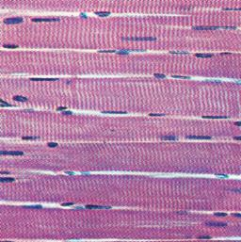
Muscle

Slide 7
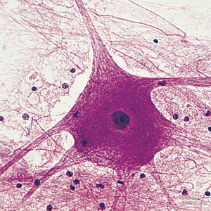
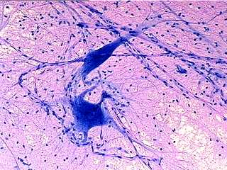
Nervous

Slide 8
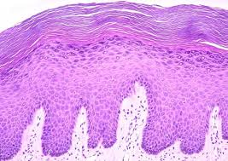
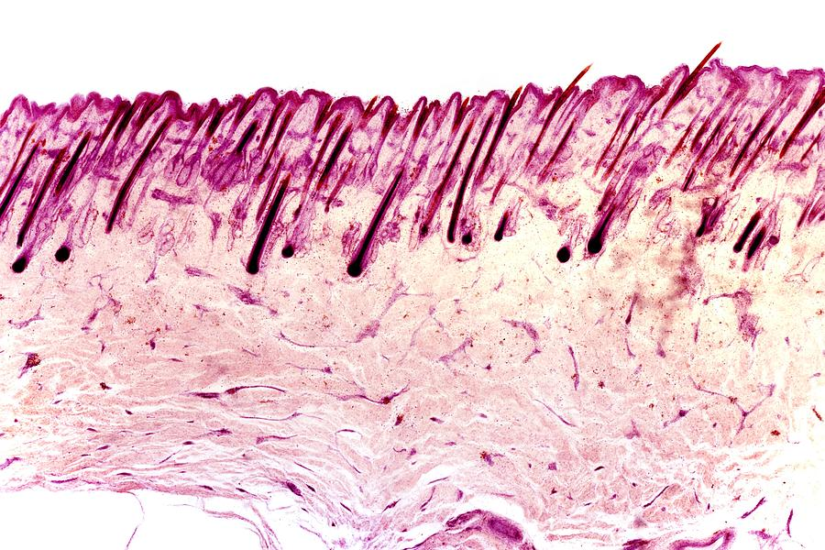
Epithelial

Slide 9
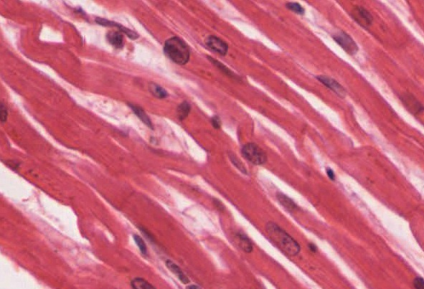
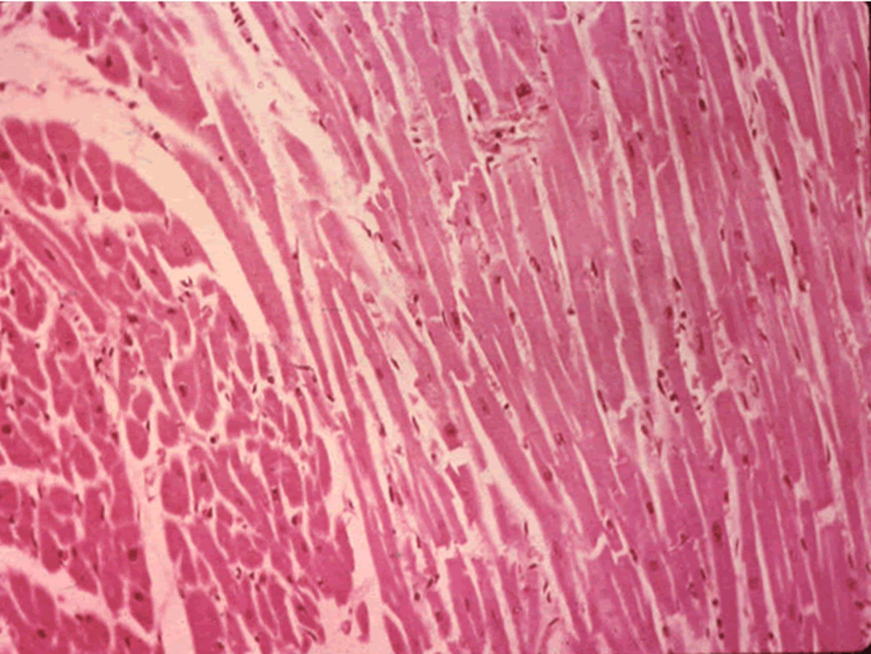
Muscle

Slide 10
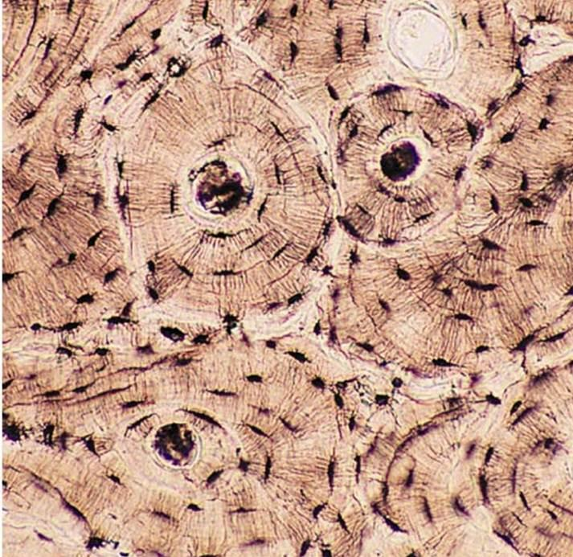
Connective

Slide 11
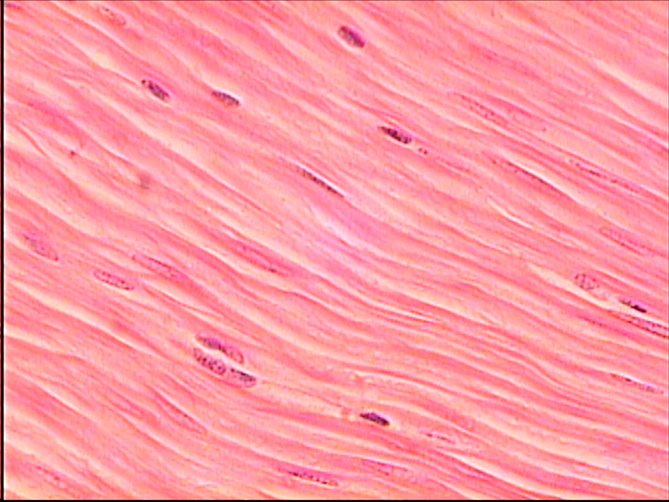
Muscle

Slide 12
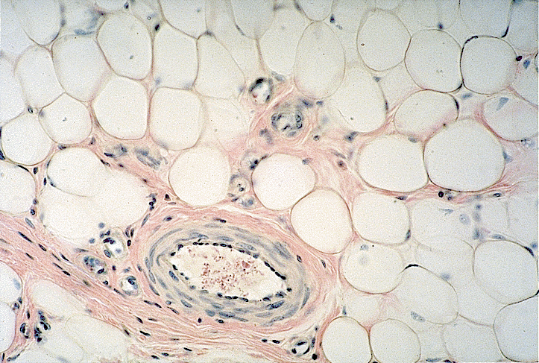
Connective

Slide 13
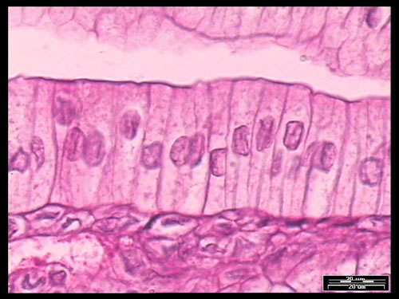
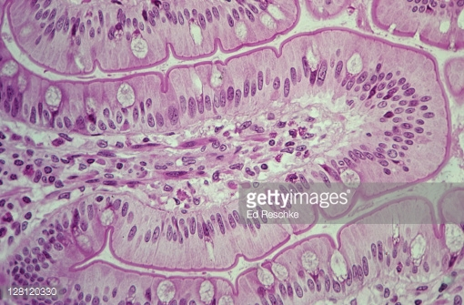
Epithelial

Slide 14
Apply your knowledge
Q 1-3, page 61
(Newton & Joyce)

